Slide 1
Injuries to Muscles,
Bones And Joints

Slide 2
4 TYPES of INJURIES
FRACTURE
DISLOCATION
SPRAIN
STRAIN

Slide 3
F R A C T U R E
A complete break, chip, or a break in the bone.
Caused by falls, twisting, large force.
4 types of fractures

Slide 4
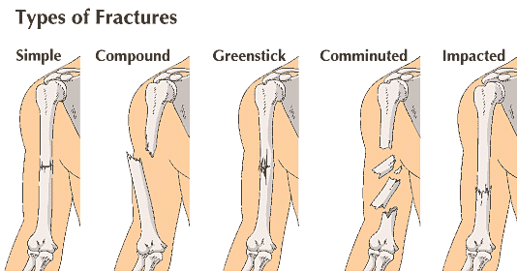

Slide 5
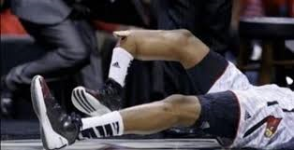

Slide 6
D I S L O C A T I O N
Movement by a bone or joint away from its original position.
Displaced bone often makes a bump or a ridge.
Most common dislocation:
  Shoulders and fingers

Slide 7
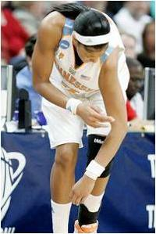

Slide 8
S P R A I N
A tearing of the ligaments at the joint.
Caused by a twisting motion or a violent blow.
Most common Sprain:
  Ankle.

Slide 9
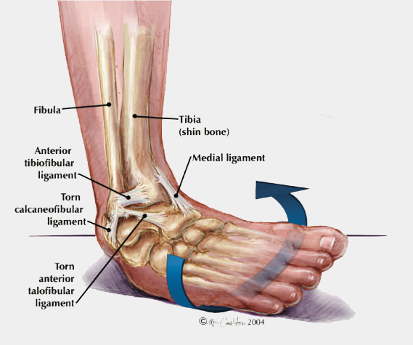
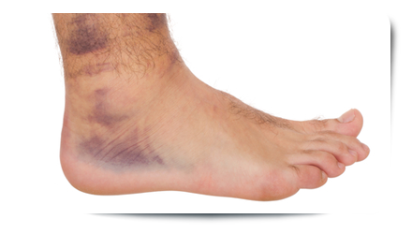

Slide 10
S T R A I N
Stretching and tearing of muscles and tendons.
Often by lifting something heavy.
Most common location:
  Lower Back and Neck.

Slide 11
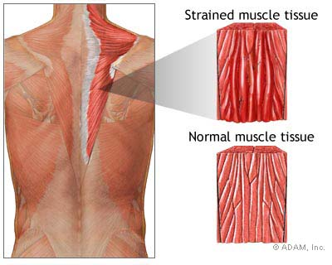

Slide 12
SIGNS OF INJURY
Significant deformity
Bruising or swelling
Inability to use the affected part normally
Bone fragments sticking out of a wound
Person feels bones grating; felt or heard a snap or pop.
Cause of injury suspects that injury may be severe
Area is cold or numb

Slide 13
SPLINTING
Never move the injury to splint!
Splint only if you can do so without causing pain.
Splint above and below the injury
Always check for circulation after splinting.

Slide 14
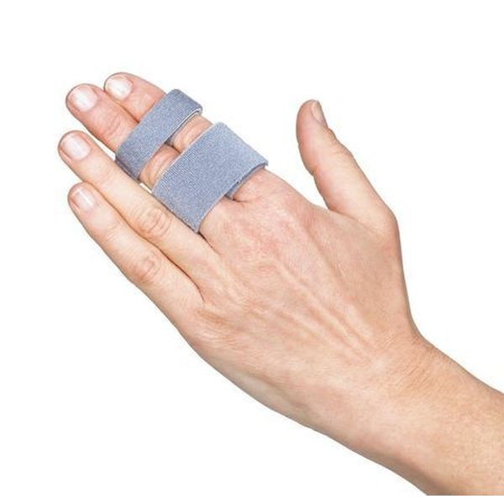
TYPES OF SPLINTS
ANATOMICAL
SPLINT

Slide 15
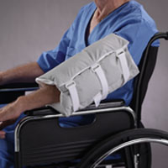
TYPES OF SPLINTS
SOFT
SPLINT

Slide 16
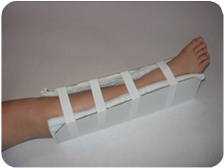
TYPES OF SPLINTS
RIGID
SPLINT

